Slide 1

Object Oriented Programming in Python
Clay Elmore
February 1, 2019

Slide 2

Procedure Oriented Programming (Traditional Programming)
Code is written to manipulate existing data
Data and actions are inherently separate
“Routines” (functions) determine the program
C, Fortran are perfect examples

Slide 3
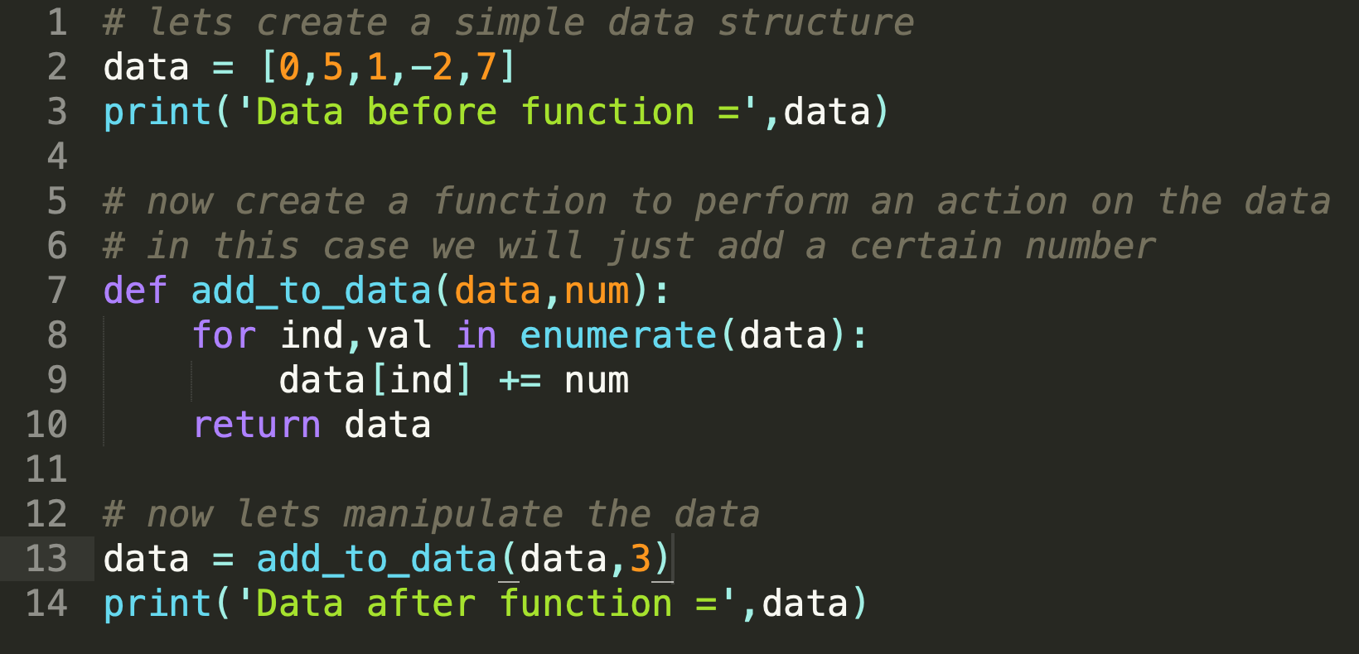
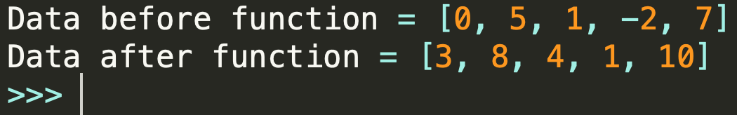
Procedure Oriented Programming Example

Slide 4
Object Oriented Programming
Data and actions are inherently coupled actions
Main Concepts:
Data Specification (Encapsulation)
Object Relationships (Inheritance)
Action Flexibility (Polymorphism)
Python, Java, C++, C Sharp are great OOP examples
Source: https://www.quora.com/What-are-the-three-principles-of-object-oriented-programming

Slide 5
Comparison

Slide 6
First Jupyter Example of OOP

Slide 7
Why to use OOP

Slide 8
Python Specific OOP

Slide 9
Downfalls of OOP

Slide 10
Recommendations of IDE’s for OOP
 | Spyder | Sublime Text | PyCharm
Pros | Easy to learn Works out of the box
Cons | Not many features Not very customizable

